Slide 1
Computer PORTS

Slide 2
PORT
The point at which a peripheral attaches to.
Port Communicates with a system unit so that the peripheral can send data to or receive information from the computer.

Slide 3
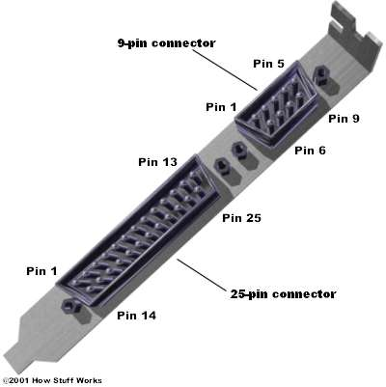
Serial Port
A serial port is a serial communication physical interface through which information transfers in or out one bit at a time.
In serial ports, there will be two data lines: One transmission and one receive line. To send a data in serial port, it has to be sent one bit after another
Serial connectors generally have 9 or 25 pins.

Slide 4
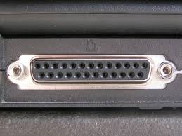
Parallel Ports
Parallel port – Allows multiple bits (E.g. 8 or 16) bits to be transmitted simultaneously.
Parallel ports are faster compared to the serial ports.

Slide 5
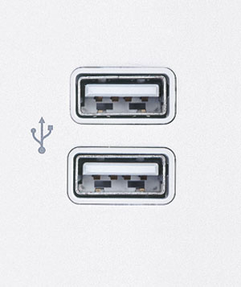
USB Ports
Universal serial bus port
Connect to up 127 different peripherals together with a single connector.
USB 2.0, also known as hi-speed USB, .it supporting a transfer rate of up to 480 Mbps.
USB 3.0 also known as Super-Speed USB is the latest version of the USB . offering data transfer speeds of up to 5 gigabits per second

Slide 6
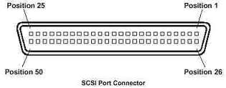
SCSI Port
SCSI is a Small Computer System Interface.
It is faster than serial and parallel but slower than usb port
A SCSI port can be used to connect a hard disk, tape drive, and optical drives.

Slide 7
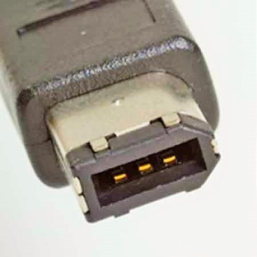
FireWire Ports
A FireWire is a device for transferring data between two or more digital devices such as digital cameras, etc.
It connect up to 63 devices o at the same time.

Slide 8

VGA Port
A Video Graphics Array (VGA) connector is a three-row 15-pin connector. The 15-pin VGA connector is found on many video cards.

